Slide 1
VolQ New UI Design Draft

Slide 2
Basic Principle
Partly Material designed
Constant pattern on Vol, Org and Orgza
Use card if possible
Same style as the android app
Use only one font but different weights
One primary color one accent color

Slide 3
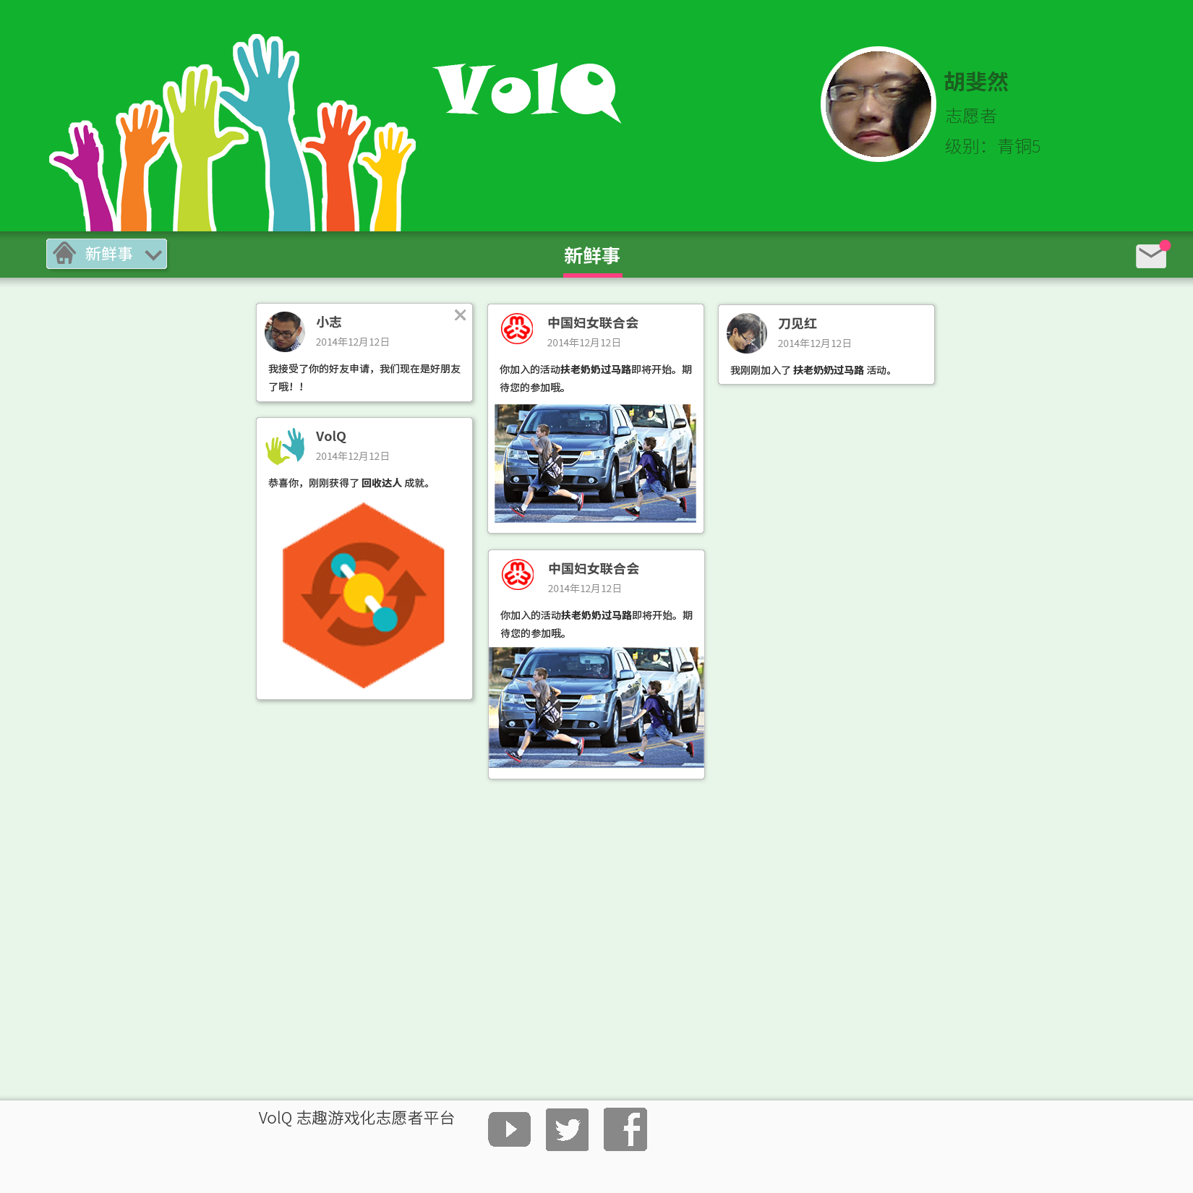
Hero Image
Avatar
Mouse over to show the clear
Feeds card

Slide 4
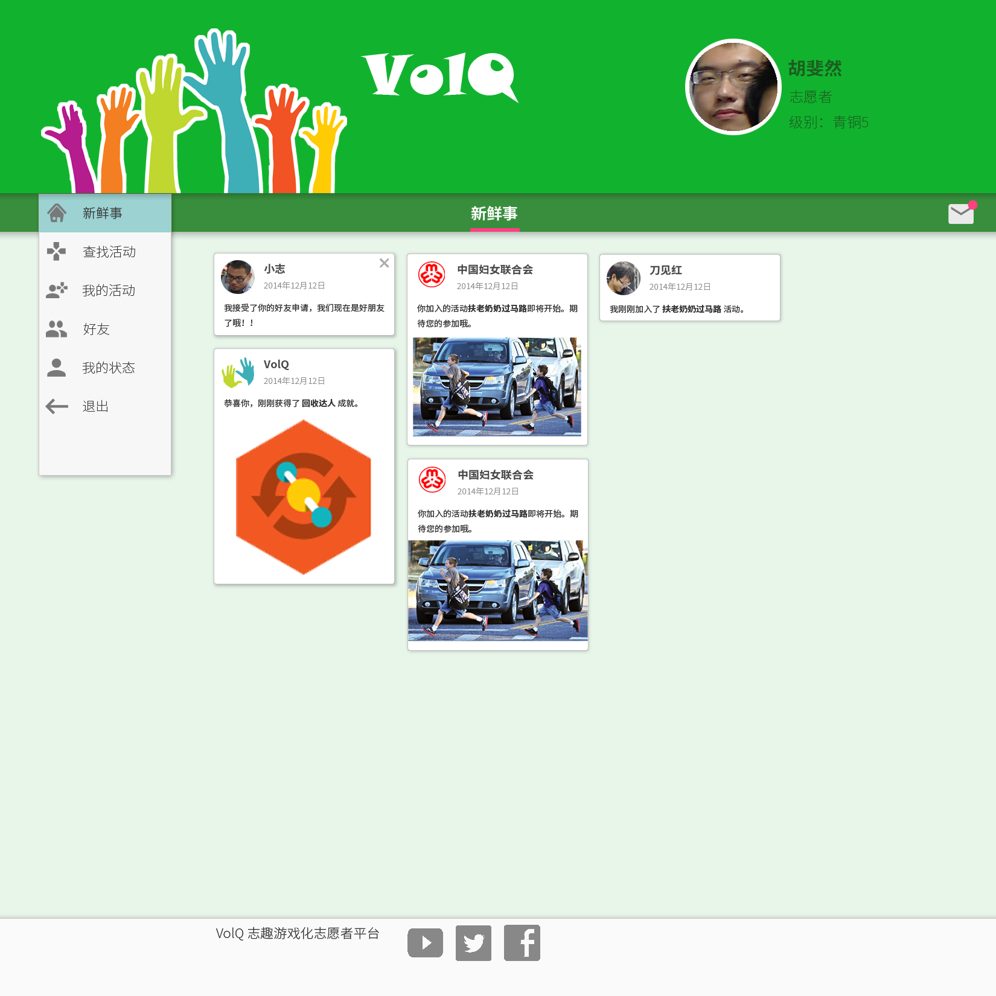

Slide 6
Remarks
The design is not final
The colors is not perfect
Although many specs is embedded in the .psd file, some alignment is not precisely done
The size of the hearer, the button and font may change
Background pictures and hero images need be chosen

